Slide 1
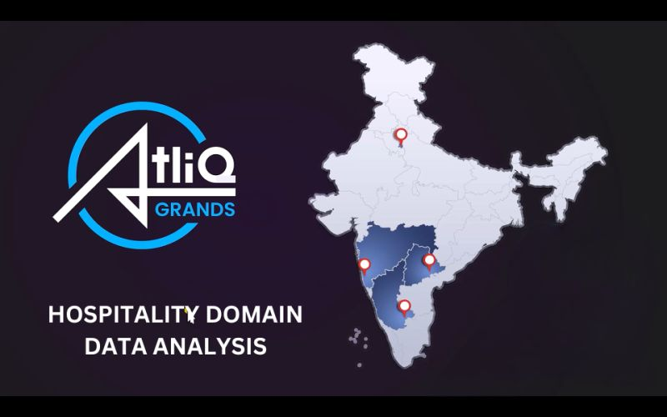
Prepared By: Shambhu Kumar Kushwaha

Slide 2
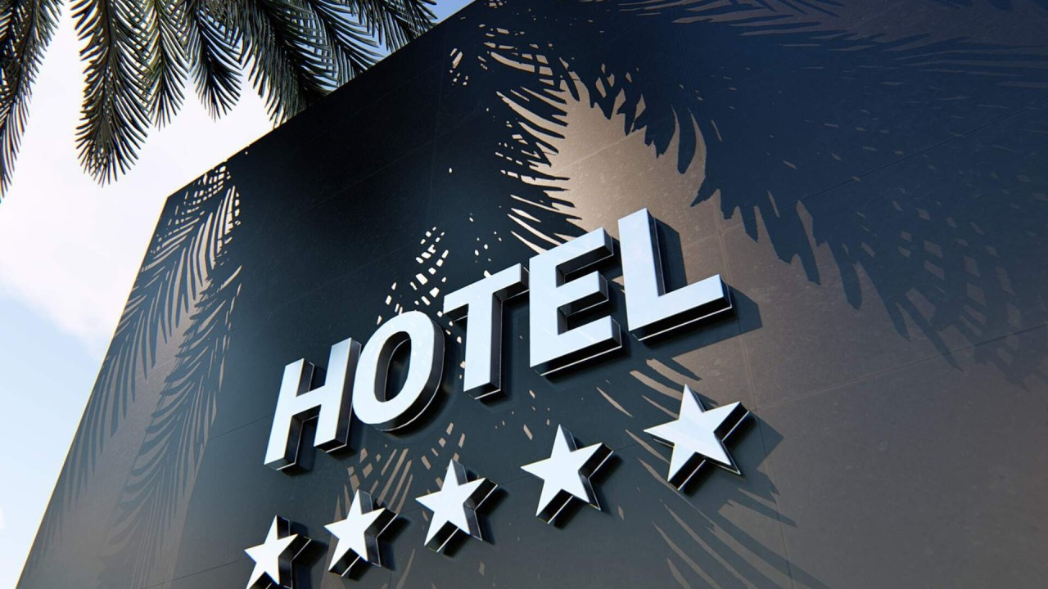
Hospitality Domain Data Analysis — Exploratory Data Analysis (EDA)
AtliQ Hotels is a leading hotel chain operating across major Indian cities, known for its premium hospitality and modern amenities. Recently, the brand has experienced a decline in market share and revenue due to rising competition.
This Exploratory Data Analysis (EDA) project, powered by Python and Pandas, aims to uncover key performance drivers, analyze booking trends, and develop data-driven strategies for business recovery and sustainable growth.

Slide 3

Business Problem
AtliQ Hotels seeks to reverse declining profitability through deeper insights into operations. Key challenges include fluctuating bookings, uneven occupancy rates, and competitive pressures in key markets. This analysis focuses on booking and occupancy trends, customer behavior patterns, and performance gaps across cities and hotel categories to empower informed, data-driven decision-making.
Booking Trends
Analyze seasonal patterns and city-wise variations to optimize occupancy and revenue management.
Customer Behavior
Understand guest preferences across room categories, booking durations, and travel periods to enhance service offerings.
Performance Gaps
Identify underperforming hotels and room segments to implement data-backed strategies for operational improvement and market competitiveness.

Slide 4
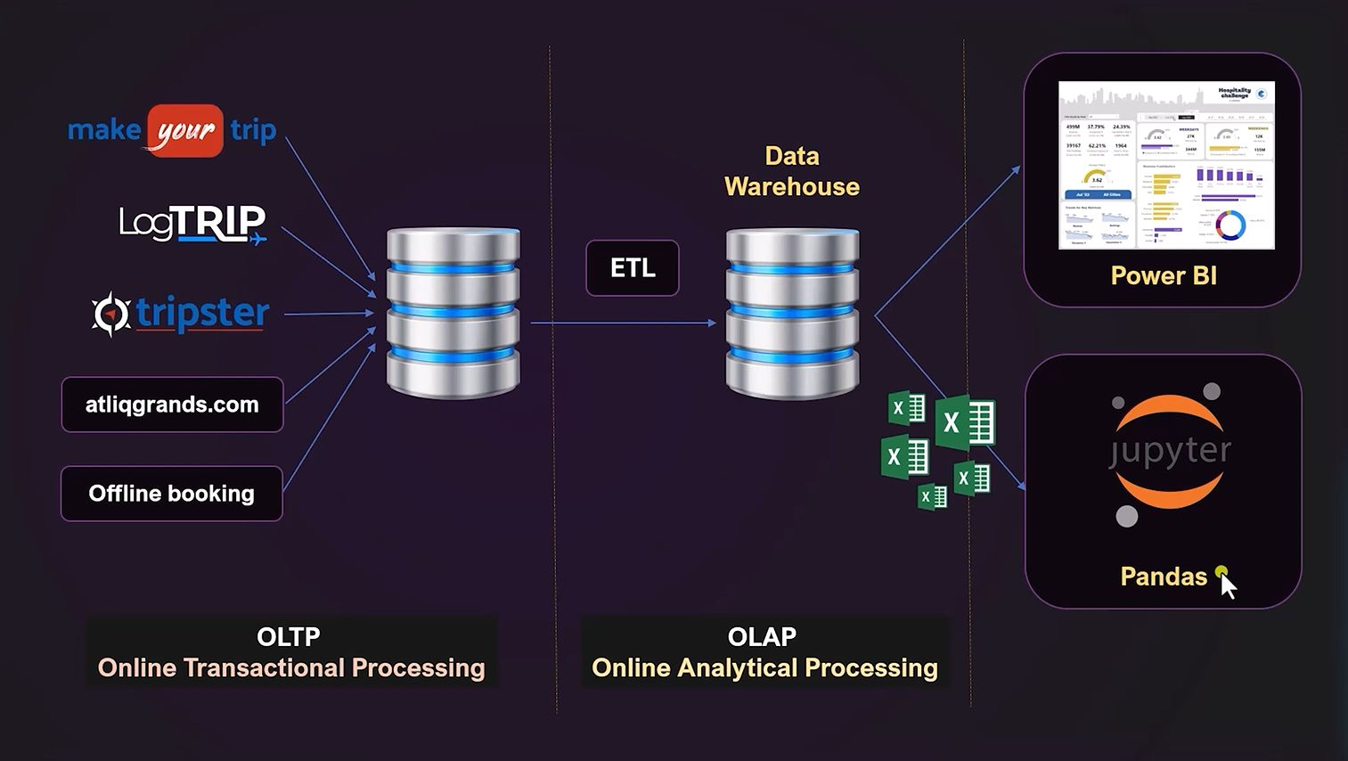
Project Objectives
The core aim of this project is to perform a comprehensive Exploratory Data Analysis (EDA) on hospitality data, transforming raw datasets into actionable strategic insights. This process involves cleaning and preparing the data, visualizing key patterns and trends, and deriving recommendations to enhance revenue, optimize occupancy rates, and improve overall operational efficiency.
01
02
End-to-End EDA
Analyze hospitality data comprehensively, from data ingestion and cleaning to interpretation and insight generation.
Data Transformation
Resolve inconsistencies, standardize formats, and merge multiple datasets to create a unified and analyzable dataset.
03
04
Pattern Visualization
Identify and visualize key trends in bookings, occupancy rates, room categories, and seasonal demand across cities.
Actionable Strategies
Generate data-driven recommendations to help management optimize revenue, improve occupancy, and address underperforming segments.

Slide 5
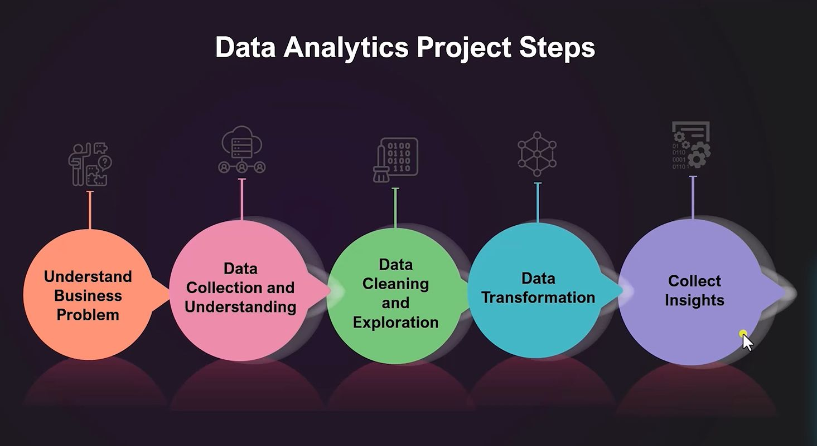
Steps Used for Analytics
Understand Business Problems: Align analysis goals with business objectives.
Data Collection & Understanding: Gather relevant datasets and explore attributes.
Data Cleaning & Exploration: Handle missing values, outliers, and inconsistent data.
Data Transformation: Reshape and merge data for analysis-ready format.
Collect Insights: Extract actionable insights to drive decision-making.

Slide 6
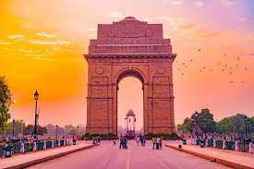
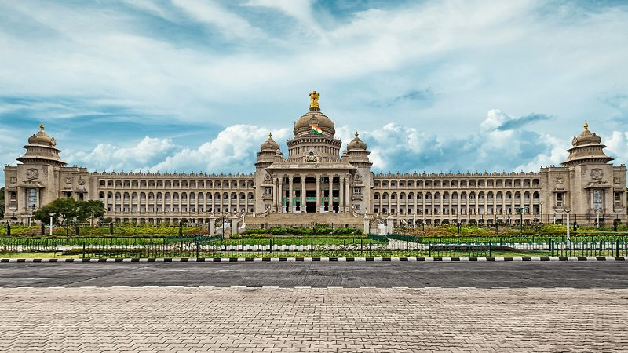
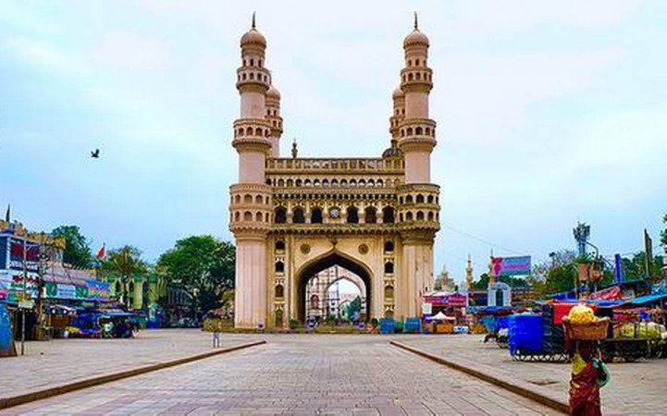
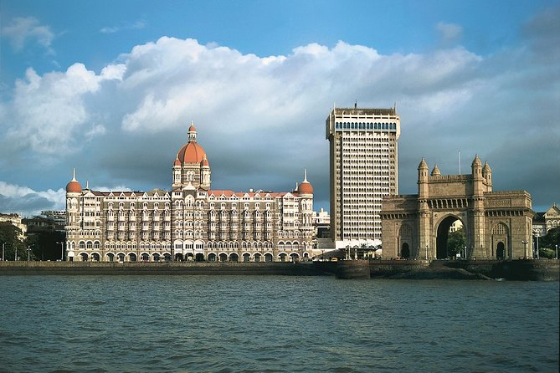
Geographical Presence
AtliQ Grands Hotels operates in four major Indian cities: Delhi, Bangalore, Hyderabad, and Mumbai. These cities were chosen strategically to cover both business and leisure travel markets. Understanding city-specific booking and occupancy patterns helps in making informed operational and marketing decisions. A map highlighting these cities can visually represent the hotel’s presence for better clarity.

Slide 7

Dataset Used
The project uses five Excel datasets, processed entirely in Python with Pandas:
dim_date.xlsx – Contains date details like year, month, week, and day type to help analyze trends over time.
dim_hotels.xlsx – Includes hotel information such as name, city, and category to compare performance across locations.
dim_rooms.xlsx – Provides details about room types, capacity, pricing, and amenities to study booking preferences.
fact_bookings.xlsx – Contains detailed booking records, including check-in/check-out dates, revenue, and customer IDs.
fact_aggregated_bookings.xlsx – Summarizes key metrics like total bookings, occupancy percentage, and average daily rates for easier trend analysis.
All data cleaning, merging, and analysis were carried out in Python using Pandas, Matplotlib, Numpy and Seaborn.
SELECT ME

Slide 8


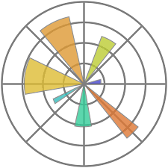




Tools & Technologies Used
Python: Programming language used for data analysis, manipulation, and visualization.
NumPy: For efficient numerical computations and array handling.
Matplotlib: For creating static and interactive visualizations.
Pandas: For data manipulation and analysis of tabular datasets.
Seaborn: For attractive statistical data visualizations.
Jupyter Notebook: Interactive platform to write, run, and visualize code.
Git/GitHub: For version control, collaboration, and reproducible workflows.

Slide 9
Data Preparation Process
Import CSVs
Load multiple files into Pandas DataFrames for initial inspection.
Clean Data
Fill missing values, remove outliers, and resolve inconsistencies in categories and dates.
Convert Formats
Parse dates to datetime objects and encode categorical variables.
Merge Datasets
Join tables on common keys like hotel ID and date for integrated views.
Derive Columns
Calculate month, week, and occupancy percentage for deeper trend analysis.

Slide 10

Exploratory Data Analysis (EDA)
EDA revealed hidden patterns in the hospitality data, focusing on temporal, geographical, and categorical factors to diagnose performance issues.
Key Focus Areas
Methodology
Seasonal trends in bookings and cancellations.
Descriptive statistics, correlation analysis, and visualizations uncovered relationships, such as peak seasons driving 30% higher occupancy.
City-wise revenue and occupancy comparisons.
Distribution across room types and categories.
Variations between weekdays and weekends.
Load Data
Clean & Prep
Explore Trends
Identify Patterns

Slide 11
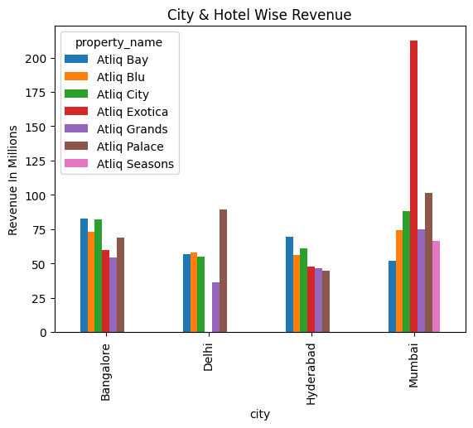
Key Insights
Atliq Exotica in Mumbai generated the highest revenue (~200M+).
Hotels in Delhi and Hyderabad showed lower revenue compared to other cities.

Slide 12
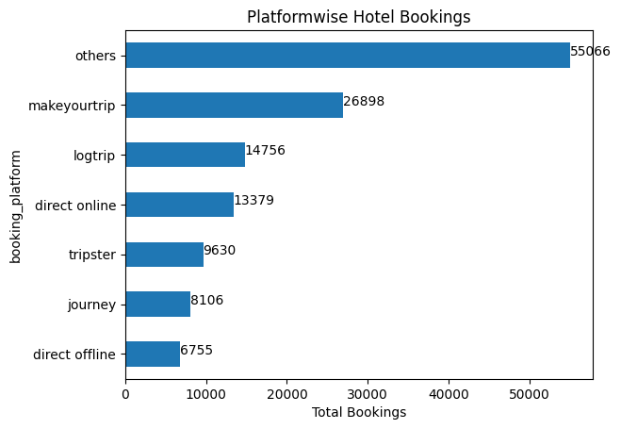
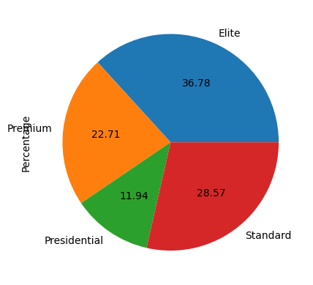
55,066 bookings were made via “Other” online platforms.
26,898 bookings came through MakeMyTrip.
6,755 bookings were offline, indicating low offline adoption.
Most customers prefer booking hotels online, highlighting the importance of digital channels.
Elite rooms have the highest booking percentage (36.78%), indicating strong customer preference.
Standard rooms follow with 28.57% bookings, showing steady demand.
Premium rooms account for 22.71%, while Presidential rooms are least booked at 11.94%, suggesting low luxury demand.
Focus marketing and promotions on Elite and Standard rooms, while exploring strategies to boost bookings for Presidential rooms.

Slide 13
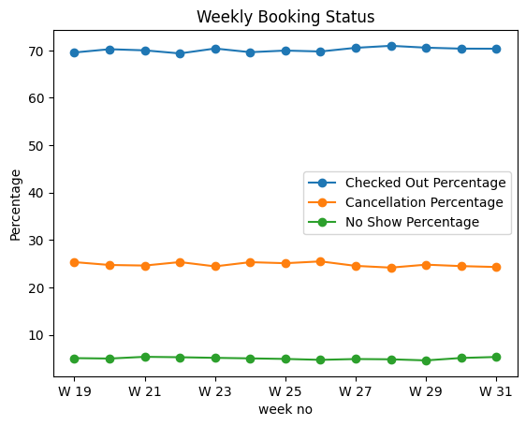
Majority of bookings (70%) successfully checked out, indicating good conversion and occupancy.
Cancelled bookings (25%) are significant, highlighting a need for cancellation management strategies.
No Show bookings (5%) are minimal, showing relatively low lost opportunities.
Focus on reducing cancellations and incentivizing confirmations to improve overall occupancy.

Slide 14
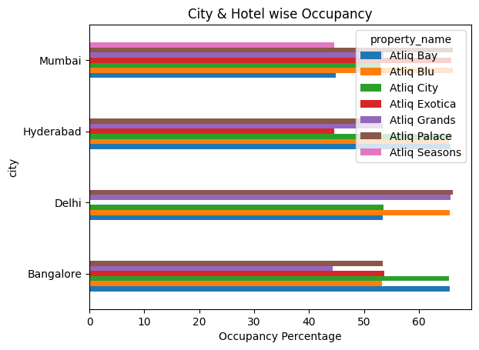
Mumbai hotels (Atliq Blu, Atliq Exotica, Atliq Palace) show high occupancy, indicating strong demand in this city.
Delhi hotels (Atliq Palace, Atliq Grands) also exhibit good occupancy, though slightly lower than Mumbai.
Bangalore and Hyderabad hotels have lower occupancy compared to Mumbai and Delhi, suggesting opportunities to boost bookings in these cities.
Focus marketing and promotions in Bangalore and Hyderabad to improve occupancy and revenue.

Slide 15
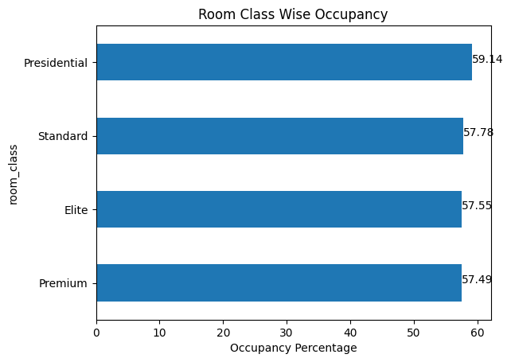
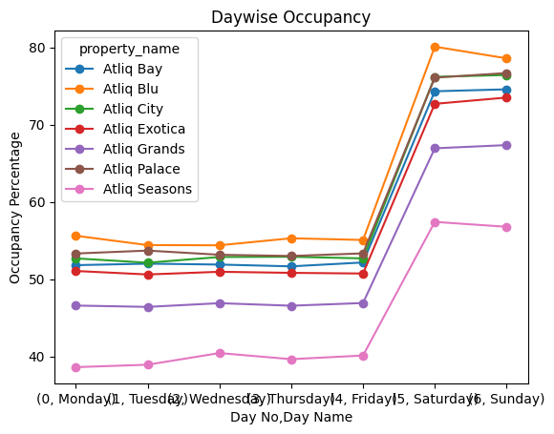
Presidential: 59.14% – highest occupancy, strong demand for luxury stays.
Standard: 57.78% – consistent bookings for budget-friendly rooms.
Elite: 57.55% – popular among mid-to-high-end customers.
Premium: 57.49% – slightly lower but stable occupancy.
Occupancy is high across all room classes, with Presidential leading slightly.
Highest Bookings: Saturday – peak occupancy day.
Next Highest: Sunday – strong weekend bookings.
Customers prefer weekend stays, indicating weekend demand is highest.

Slide 16

Conclusion
Weekend Demand: Highest bookings on Saturdays and Sundays indicate strong weekend preference.
City Performance: Mumbai hotels like Atliq Exotica and Atliq Blu lead in revenue and occupancy; Delhi performs moderately; Bangalore and Hyderabad show room for growth.
Room Type Trends: Elite rooms are most booked, followed by Standard, Premium, and Presidential.
Booking Channels: Majority of customers book online, highlighting the importance of digital platforms.
Occupancy Patterns: Presidential and Standard rooms show slightly higher occupancy; overall occupancy trends help optimize resource allocation.
Overall: Insights from this EDA can guide revenue optimization, targeted marketing, and strategic operational improvements across cities and room types.

Slide 17


